Slide 1
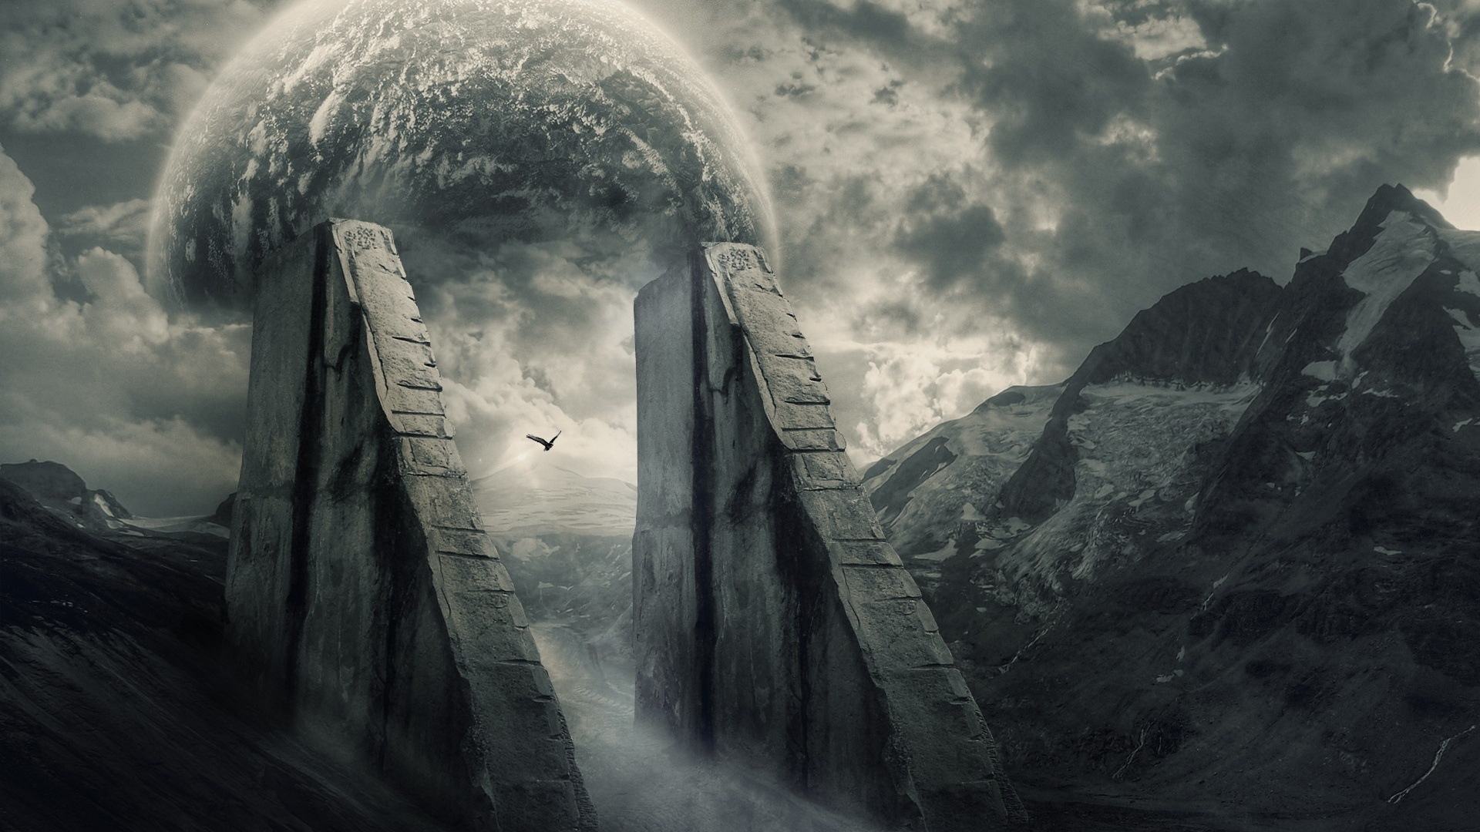
Blade of the Lost: The Silent Survivor Progress Report 3:
Developers: Josef Bacík (312553801) and Eduin Hernandez (艾德文 - 0860828)
Group #19
Instructor: 黃世強
https://wallpapersafari.com/w/Ppzkj5

Slide 2
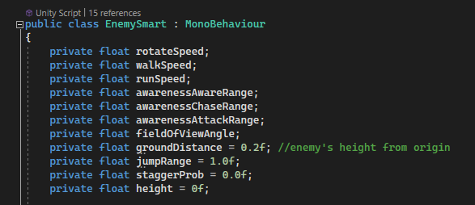
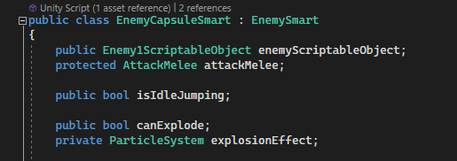
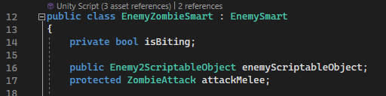
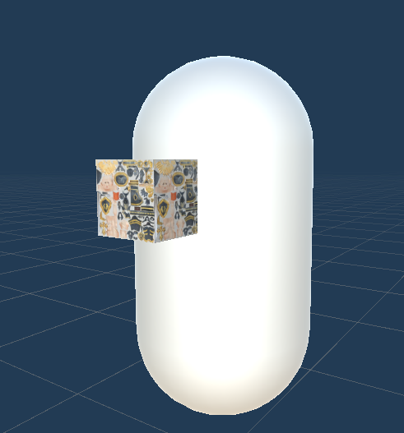
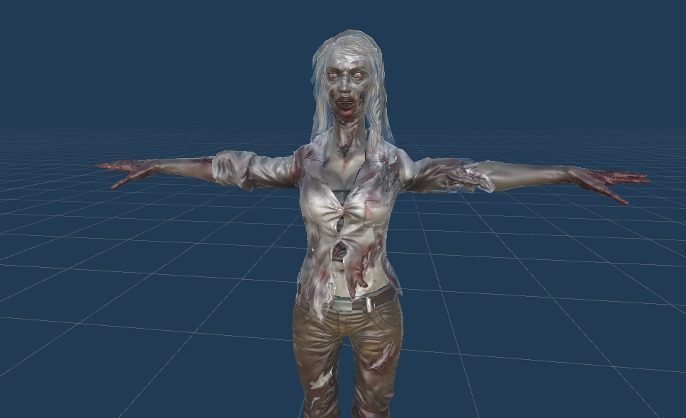
Base Enemy Class
CAPSULE
Zombie
Attack Features
Close Range Shot
Self-Destruct Explosion
Attack Features
Arm Swing
Bite

Slide 3
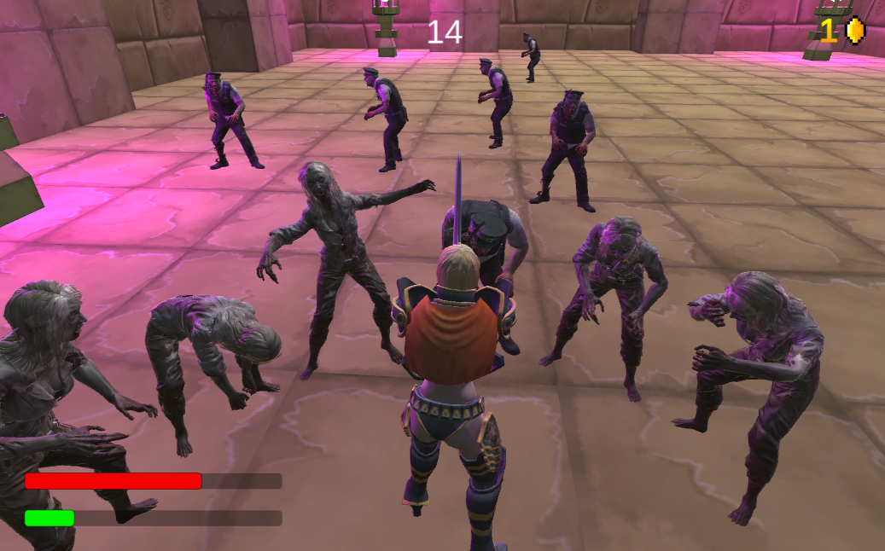
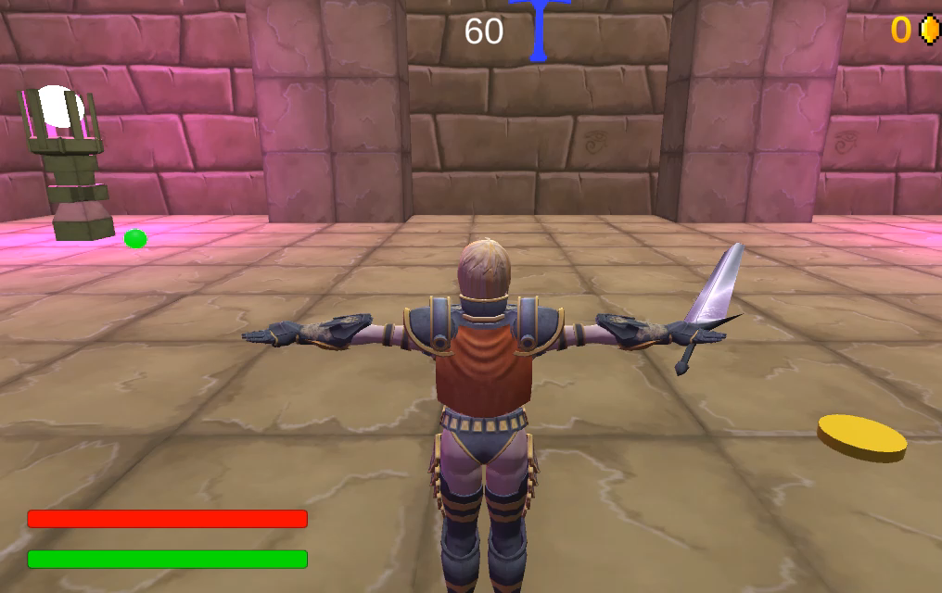
New Enemies - ZOmbie

Slide 4
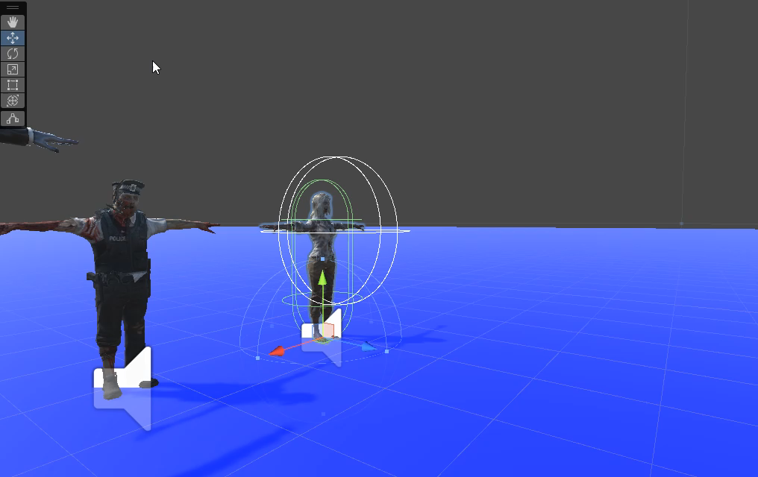
Zombie Animations

Slide 5
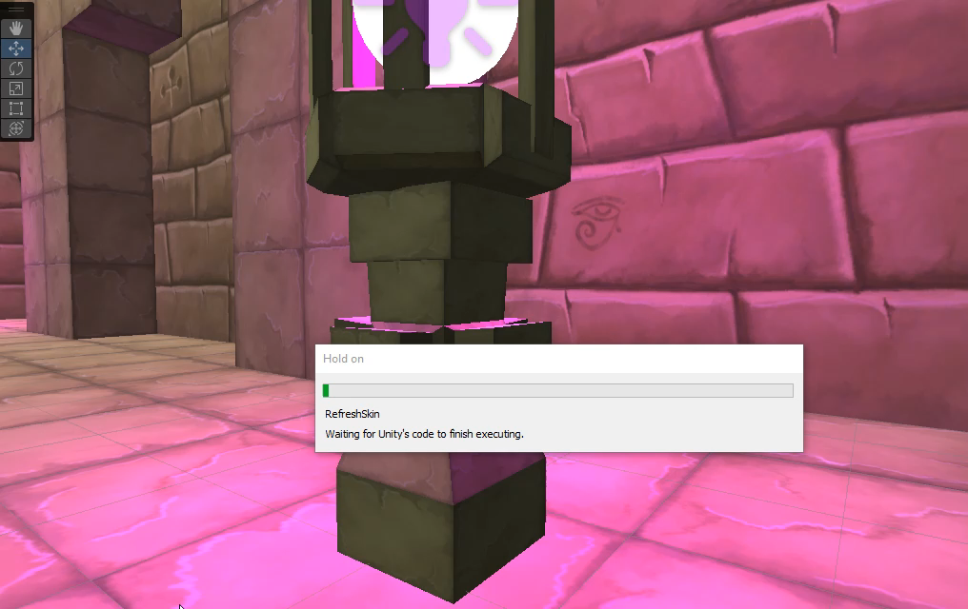
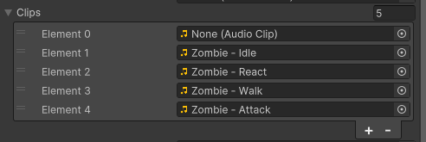
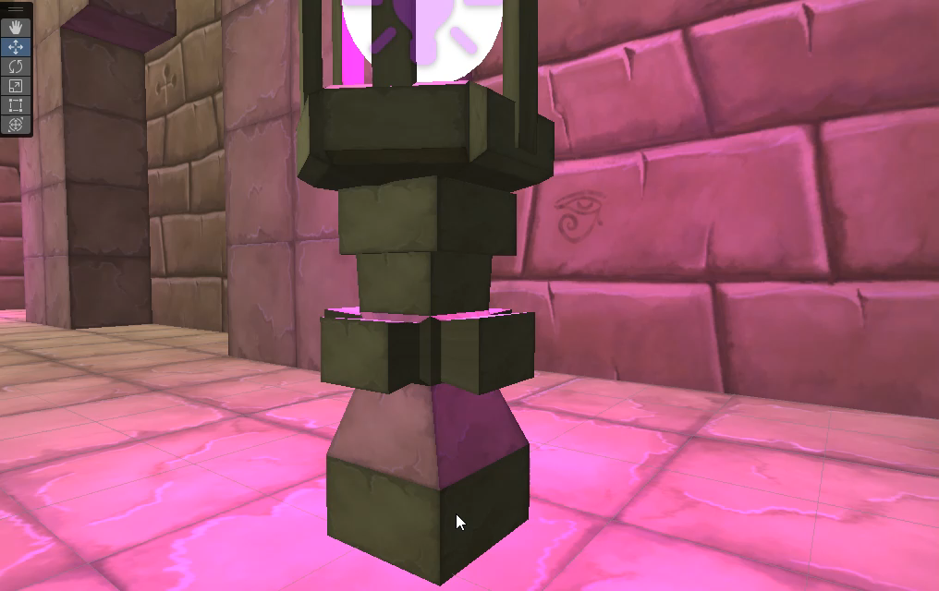
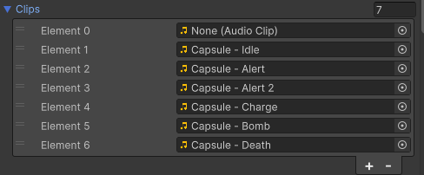
NEW Enemy SOunDS

Slide 6
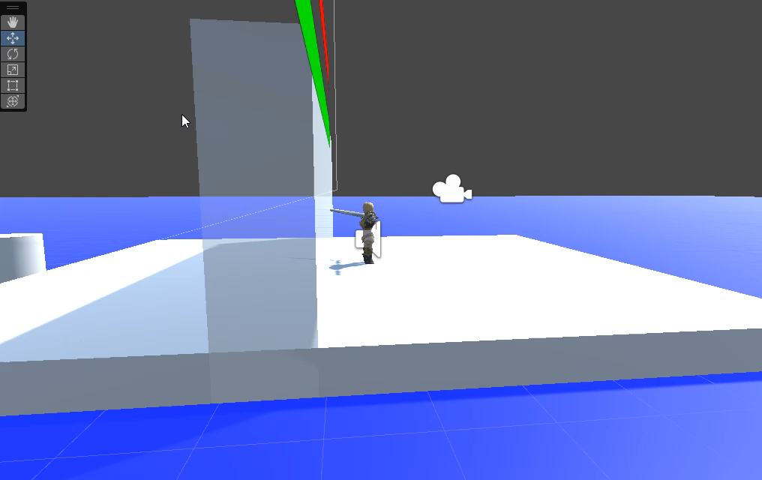
New Behaviour Features
No Player Detection on Occlusion
Movement Direction Memory
Player Location Memory

Slide 7
THANK YOU!

Slide 8
Introduction
I invite you to step into a world of mystery and danger, where you, the player, find yourself in the most peculiar predicament. Awaken in a place that defies your understanding, devoid of any memories or knowledge about who you are or how you got there. The world around you is a chaotic, hostile landscape, teeming with bizarre and menacing creatures, each shrouded in its own enigma.
Armed with a mysterious sword and an unyielding determination to survive, your journey unfolds through relentless battles against these nightmarish foes. As you defeat your adversaries, uncover hidden relics, and gain newfound abilities, you empower yourself on this enigmatic quest. Each step into the unknown brings you closer to unraveling the mysteries of this world.
"Blade of the Lost: The Silent Survivor" is an epic adventure that challenges your combat skills, where survival is not just a choice but an obsession.

